Slide 1

Swansea university
Team Echo

Slide 2
Group members
Mohammed Alazmi
Nawaf Alenzi
Khaled AlDousari
Dalya Hayyad
Abrar AlEidan
Ayoub Ali

Slide 3
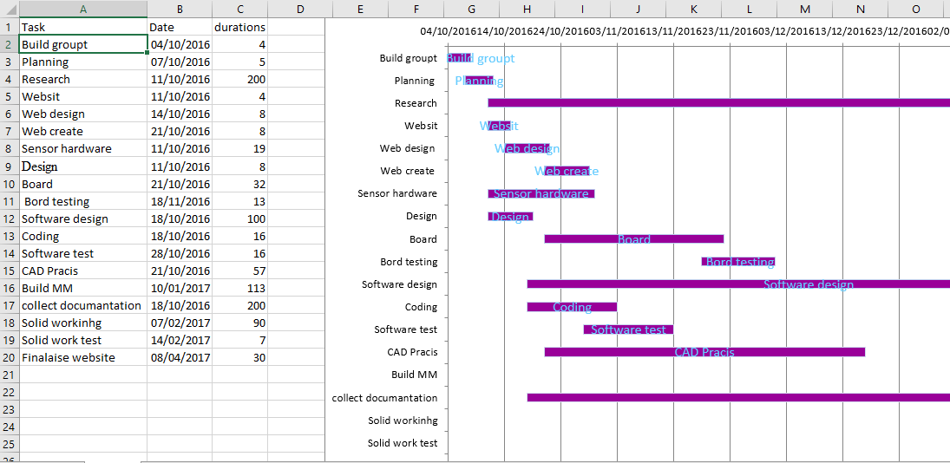
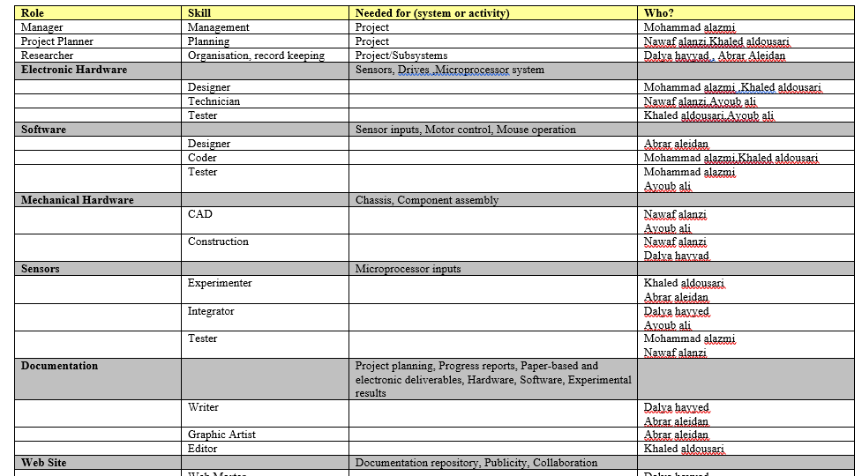
Skill matrix
Gantt Chart

Slide 4
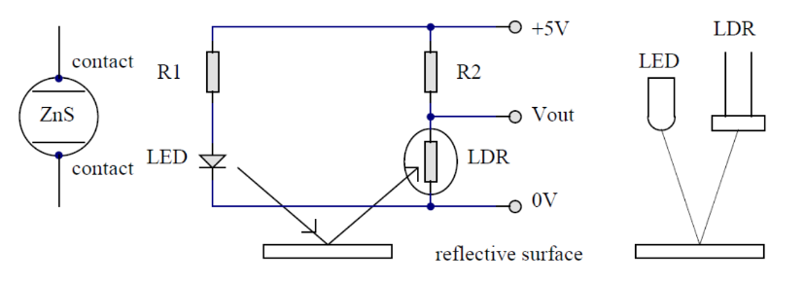
White line sensor

Slide 5

Hardware
Structure of Hardware
PCB design

Slide 6
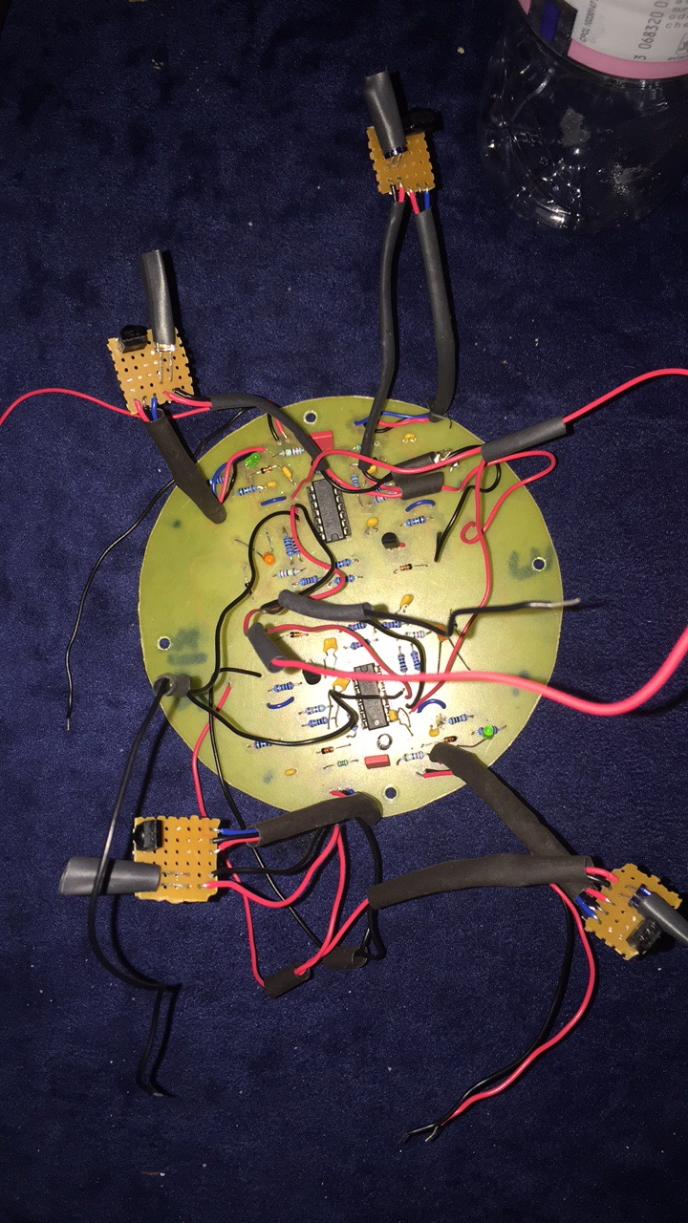
PCB
Protous Program
Collecting components

Slide 7

Website
Blogging
Categories
Weekly updates

Slide 8
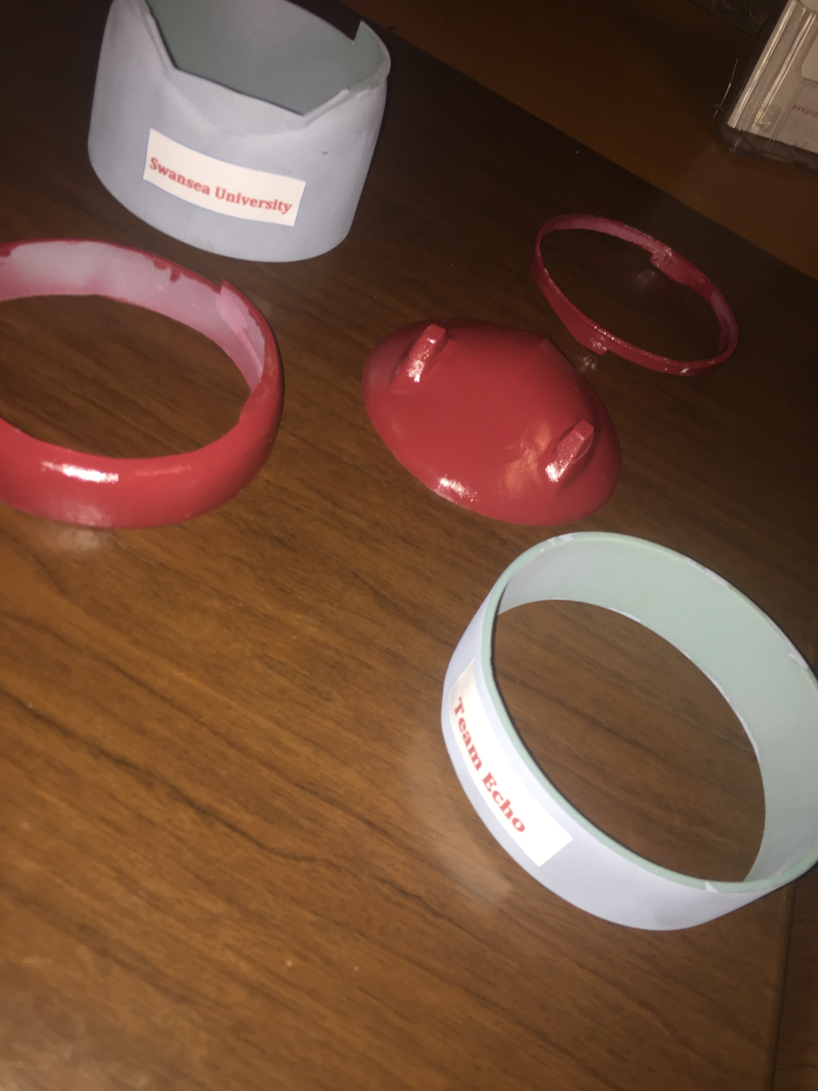
Body
Autodisk Maya program
Guard
Printing 3d by parts

Slide 9
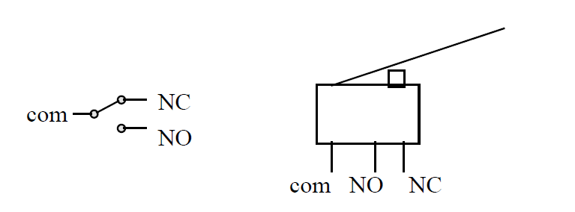
Touch Bar
Normally closed (NC)
Normally Open (NO)

Slide 10
Ethics Of Robots
Safety first.
Errors, Maintenance, software.. Of home robots.
Law of manufacturing of robots are necessary.

Slide 11
Conclusion
From October until May we trasphered a small components to a micro mouse, which was not easy to build but we worked too hard and we were supportive to teach each other.

